Slide 1
CS 1520 COMPUTER ARCHITECTURE
Prof. Peter Edwards
p.edwards@abdn.ac.uk
Notes:
Some slides in this set adapted from:
Digital Design and Computer Architecture, 2nd Edition
David Money Harris and Sarah L. Harris

Slide 2
Combinational vs Sequential Logic

Slide 3
Types of Logic Circuit
Combinational Logic
Outputs determined by values of inputs
No memory
Lots of examples in last few lectures!
Sequential Logic
Outputs depend on current and prior input values
Has memory (short-term)

Slide 4
Sequential Logic
Outputs of sequential logic depend on current and prior input values – it has memory.
Some definitions:
State: all the information about a circuit necessary to explain its future behaviour
Latches and flip-flops: state elements that store one bit of state
Synchronous sequential circuits: combinational logic followed by a bank of flip-flops

Slide 5
Combinational Logic

Slide 6
Combinational Logic
Rules for combinational composition
Every element in combinational
Every node is either an input or connects to exactly one output.
The circuit contains no cyclic paths
Example

Slide 7
Combinational Circuits: Half Adder
Combinational logic circuits give us many useful devices.
One of the simplest is the half adder, which finds the sum of two bits.
Consider the truth table
How might we build this?
Inputs
Outputs
X | Y | Sum | Carry
0 | 0 | 0 | 0
0 | 1 | 1 | 0
1 | 0 | 1 | 0
1 | 1 | 0 | 1

Slide 8
Half Adder
The sum can be found using the XOR operation and the carry using the AND operation.
Inputs
Outputs
X
Sum
X | Y | Sum | Carry
0 | 0 | 0 | 0
0 | 1 | 1 | 0
1 | 0 | 1 | 0
1 | 1 | 0 | 1
Y
Carry

Slide 9
Combinational Circuits: Full Adder
We can change our half adder into to a full adder by including gates for processing the carry bit.
Truth table for a full adder
Inputs
Outputs
X | Y | Carry In | Sum | Carry Out
0 | 0 | 0 | 0 | 0
0 | 0 | 1 | 1 | 0
0 | 1 | 0 | 1 | 0
0 | 1 | 1 | 0 | 1
1 | 0 | 0 | 1 | 0
1 | 0 | 1 | 0 | 1
1 | 1 | 0 | 0 | 1
1 | 1 | 1 | 1 | 1

Slide 10
Full Adder
How can we change the half adder shown below to make it a full adder?
Inputs
Outputs
X | Y | Carry In | Sum | Carry Out
0 | 0 | 0 | 0 | 0
0 | 0 | 1 | 1 | 0
0 | 1 | 0 | 1 | 0
0 | 1 | 1 | 0 | 1
1 | 0 | 0 | 1 | 0
1 | 0 | 1 | 0 | 1
1 | 1 | 0 | 0 | 1
1 | 1 | 1 | 1 | 1
X
Sum
Y
Carry

Slide 11
Full Adder
A completed full adder:
Inputs
Outputs
X | Y | Carry In | Sum | Carry Out
0 | 0 | 0 | 0 | 0
0 | 0 | 1 | 1 | 0
0 | 1 | 0 | 1 | 0
0 | 1 | 1 | 0 | 1
1 | 0 | 0 | 1 | 0
1 | 0 | 1 | 0 | 1
1 | 1 | 0 | 0 | 1
1 | 1 | 1 | 1 | 1
Carry In
Sum
X
Y
Carry Out
Notes:
Other types of combinational circuits:
decoders
multiplexers

Slide 12

Ripple-Carry Adder
Just as we combined half adders to make a full adder, full adders can connected in series.
The carry bit “ripples” from one adder to the next; hence, this configuration is called a ripple-carry adder.
Notes:
NB Today’s systems employ more efficient adders.

Slide 13
Decoders
Decoders are another important type of combinational circuit.
Among other things, they are useful in selecting a memory location according to a binary value placed on the address lines of a memory bus.
Address decoders with n inputs can select any of 2^{n} locations.
•
•
•
Decoder
•
•
•
N inputs
2^{N} outputs
Notes:
A combinational logic circuit that converts a binary integer value to an associated pattern of output bits. They are used in a wide variety of applications, including seven segment displays, and memory address decoding.

Slide 14
2:4 Decoder
Notes:
One-hot output: only one output HIGH at once

Slide 15
2:4 Decoder Implementation
Implement a 2:4 decoder with AND, OR, and NOT gates.
In general, an N:2^{N} decoder can be constructed from 2^{N} N-input AND gates that accept the various combinations of true or complementary inputs.
Each output in a decoder represents a single minterm.
A₁A₀
A₁A₀
A₁A₀
A₁A₀

Slide 16
Multiplexers
A multiplexer does just the opposite of a decoder.
It selects a single output from several inputs.
The particular input chosen for output is determined by the value of the multiplexer’s control lines.
To be able to select among n inputs, log₂n control lines are needed.
I₀
I₁
Multiplexer (MUX)
Output
I₂
I₃
S₁
S₂
Control lines
Notes:
An electronic multiplexer can be considered as a multiiple-input, single-output switch.
log2(4) = 2; log2(8) = 3 etc…

Slide 17
Multiplexer (Mux)
Choose an output from among several possible inputs based on the value of a select signal.
Note the multiplexer symbol - a trapezoid showing inputs D₀, D₁ (left), output Y (right) and control S
S | D₀ | D₁ | Y
0 | 0 | 0 | 0
0 | 1 | 0 | 1
0 | 0 | 1 | 0
0 | 1 | 1 | 1
1 | 0 | 0 | 0
1 | 1 | 0 | 0
1 | 0 | 1 | 1
1 | 1 | 1 | 1
S | Y
0 | D₀
1 | D₁
S
D₀
0
Y
D₁
1
2:1 Mux
Notes:
The schematic symbol for a multiplexer is an isosceles trapezoid with the longer parallel side containing the input pins and the short parallel side containing the output pin.
The schematic on the slideshows a 2-to-1 multiplexer .

Slide 18
Multiplexer Implementation
D₀
A multiplexer can be built from SOP (sum-of-products) logic.
The Boolean equation may be derived with a K-map…
S
D₁
Y = D₀S + D₁S
Y
S | D₀ | D₁ | Y
0 | 0 | 0 | 0
0 | 1 | 0 | 1
0 | 0 | 1 | 0
0 | 1 | 1 | 1
1 | 0 | 0 | 0
1 | 1 | 0 | 0
1 | 0 | 1 | 1
1 | 1 | 1 | 1
Y
D₀D₁
S
00
01
11
10
0
0
0
1
1
1
1
0
0
1

Slide 19
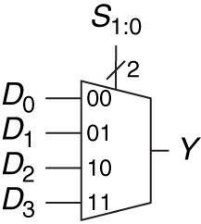
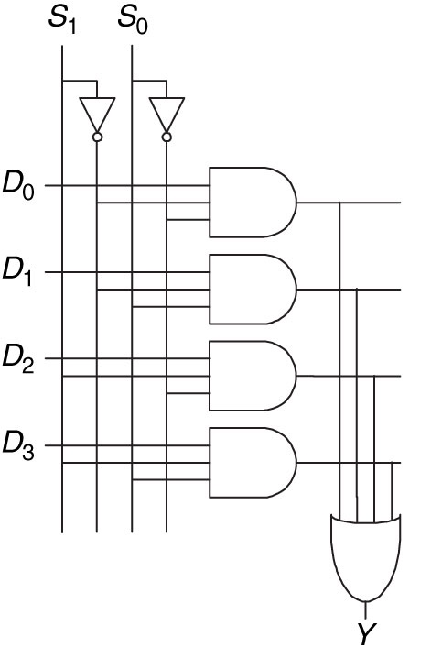
4:1 Multiplexer
A 4:1 multiplexer has 4 data inputs and one output. Two select signals are needed to choose among the 4 data inputs.
Wider multiplexers, such as 8:1 and 16:1 can be built by expanding the model shown to the right.
In general an N:1 multiplexer needs log₂N select lines.
S₀S₁D₀
S₀S₁D₁
S₀S₁D₂
S₀S₁D₃

Slide 20
Logic Using Multiplexers
D₀
D₁
Multiplexers can be used as a lookup table to perform a logic function.
The 4:1 multiplexer shown to the right can be used to implement a 2-input AND gate.
In general, a 2^{N} input multiplexer can be programmed to perform any N-input logic function by applying 0’s and 1’s to the appropriate data inputs.
A | B | Y
0 | 0 | 0
0 | 1 | 0
1 | 0 | 0
1 | 1 | 1
A B
Y = AB
00
01
Y
10
11

Slide 21
Logic Using Multiplexers
A
AND gate
A | B | Y
0 | 0 | 0
0 | 1 | 0
1 | 0 | 0
1 | 1 | 1
A | Y
0 | 0
1 | B
0
Y
B
1
Y = AB
A
XOR gate
A | B | Y
0 | 0 | 0
0 | 1 | 1
1 | 0 | 1
1 | 1 | 0
A | Y
0 | B
1 | B
B
0
Y
B
1
Y = A + B

Slide 22
Example – Logic with Mux
We need to implement the following function:
Y = AB + BC + ABC
We have a 4:1 multiplexer and an inverter.
How do we implement the function?
A | B | C | Y
0 | 0 | 0 | 1
0 | 0 | 1 | 0
0 | 1 | 0 | 0
0 | 1 | 1 | 1
1 | 0 | 0 | 1
1 | 0 | 1 | 1
1 | 1 | 0 | 0
1 | 1 | 1 | 0

Slide 23
Example – Logic with Mux
Solution:
We reduce the truth table to 4 rows by letting the output depend on C.
We can also choose to rearrange the columns of the truth table to let the output depend on A or B.
A | B | C | Y
0 | 0 | 0 | 1
0 | 0 | 1 | 0
0 | 1 | 0 | 0
0 | 1 | 1 | 1
1 | 0 | 0 | 1
1 | 0 | 1 | 1
1 | 1 | 0 | 0
1 | 1 | 1 | 0
A B
A | B | Y
0 | 0 | C
0 | 1 | C
1 | 0 | 1
1 | 1 | 0
00
C
01
Y
10
11

